Slide 1
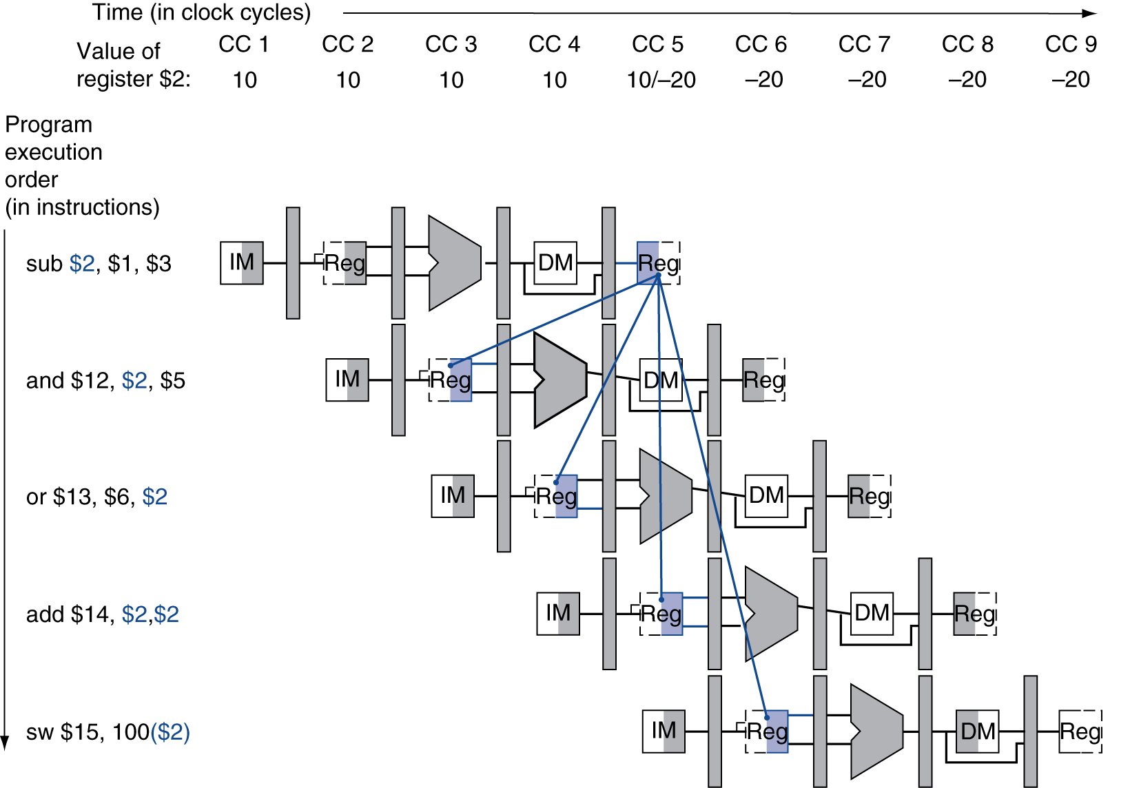
Dependencies & Forwarding

Slide 2
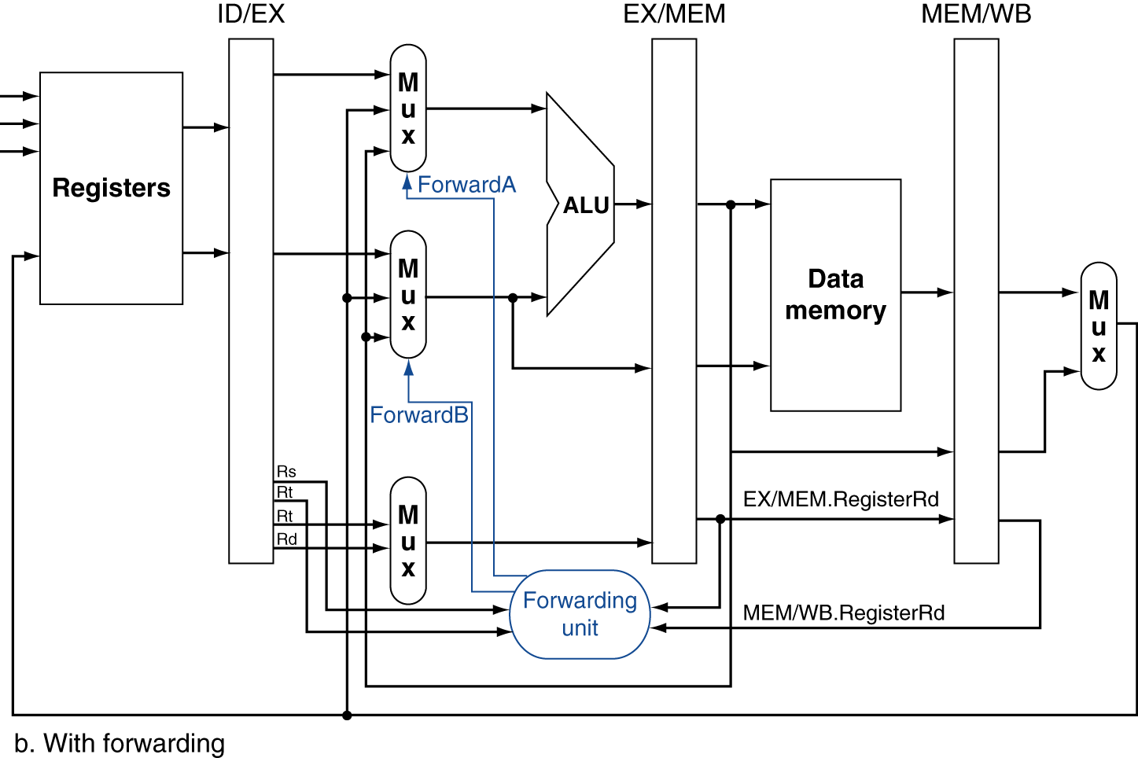
Forwarding Paths

Slide 3
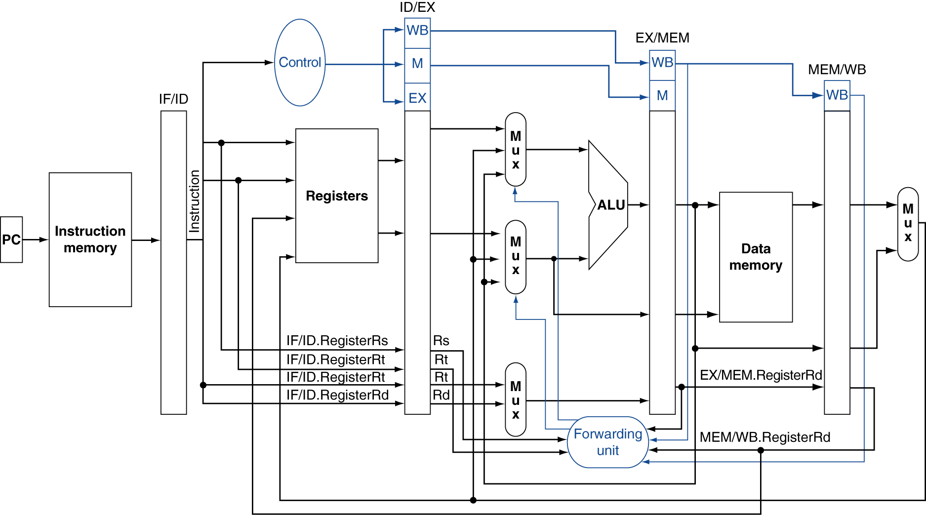
Datapath with Forwarding

Slide 4
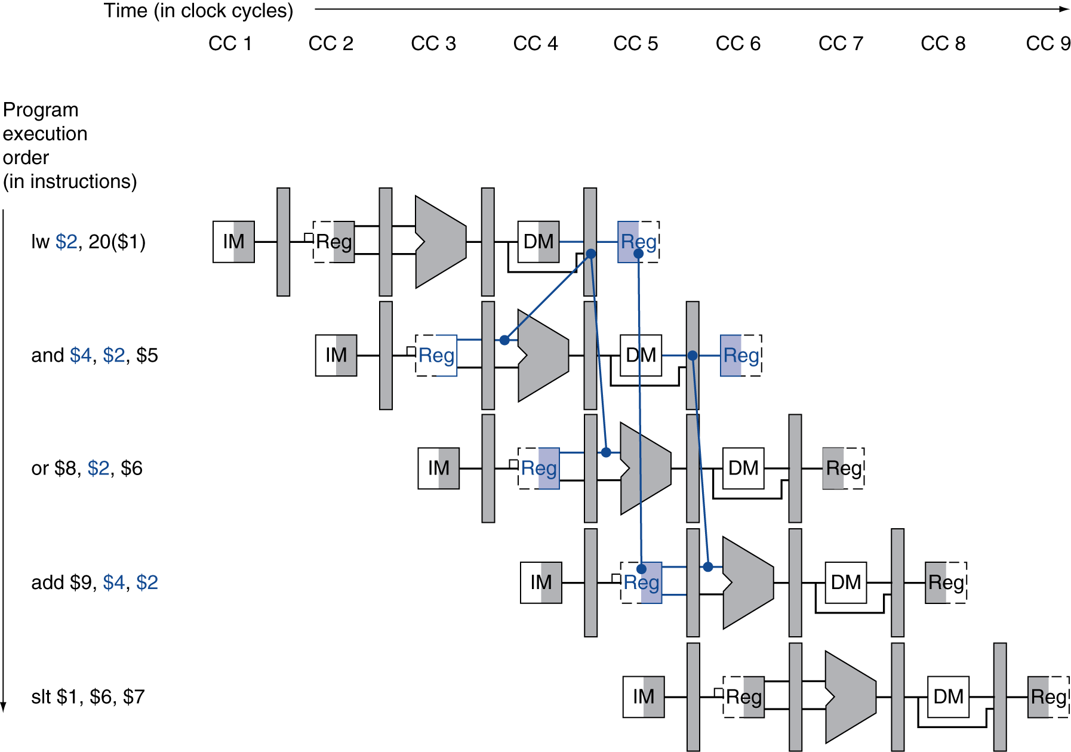
Load-Use Data Hazard
Need to stall for one cycle

Slide 5
How to Stall the Pipeline
Force control values in ID/EX register to 0
EX, MEM and WB do nop (no-operation)
Prevent update of PC and IF/ID register
Using instruction is decoded again
Following instruction is fetched again
1-cycle stall allows MEM to read data for lw
Can subsequently forward to EX stage

Slide 6
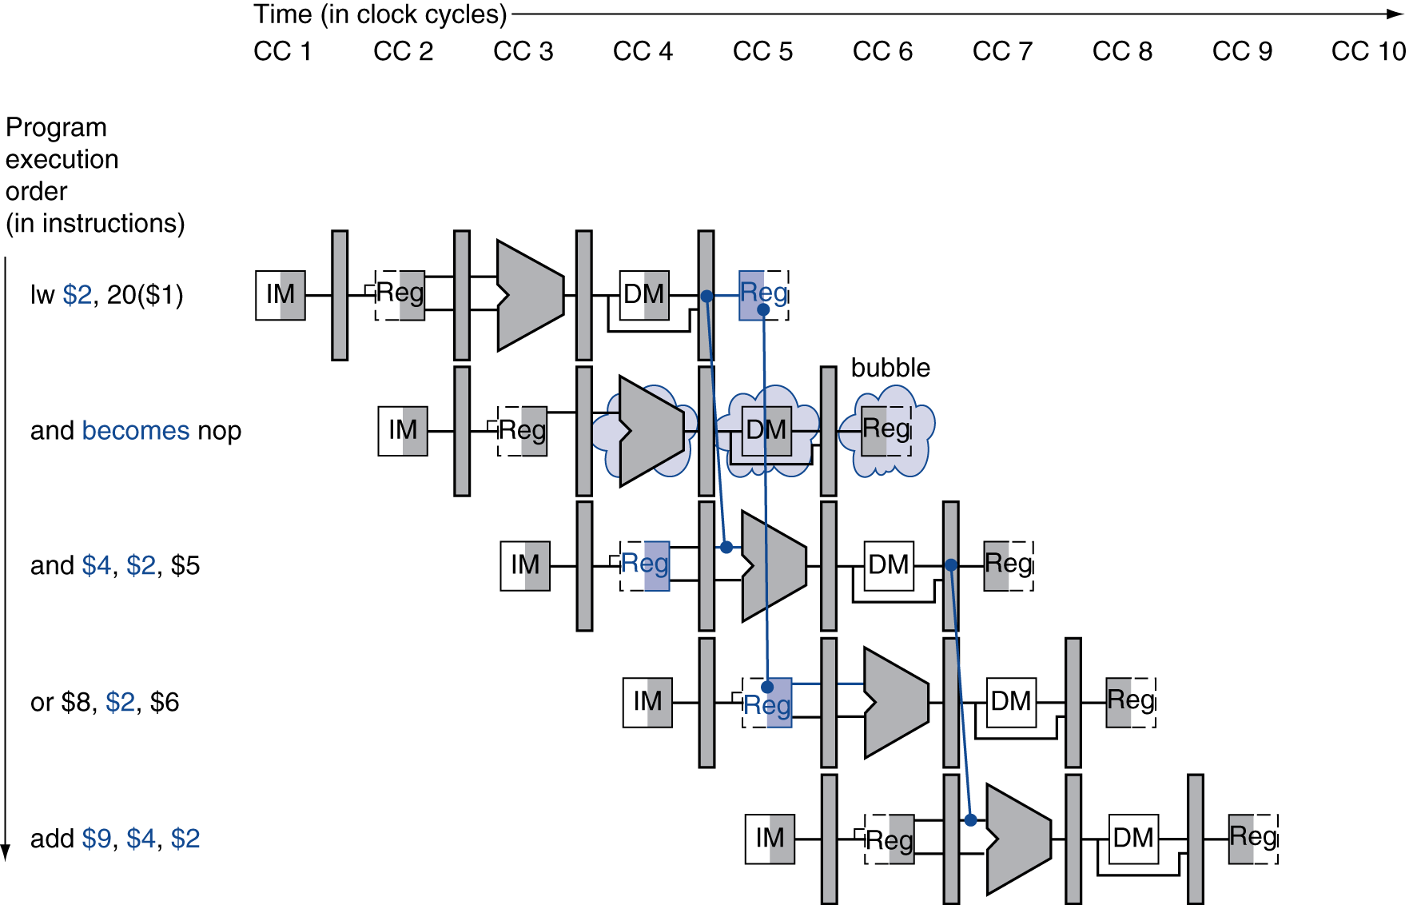
Stall/Bubble in the Pipeline
Stall inserted here

Slide 7
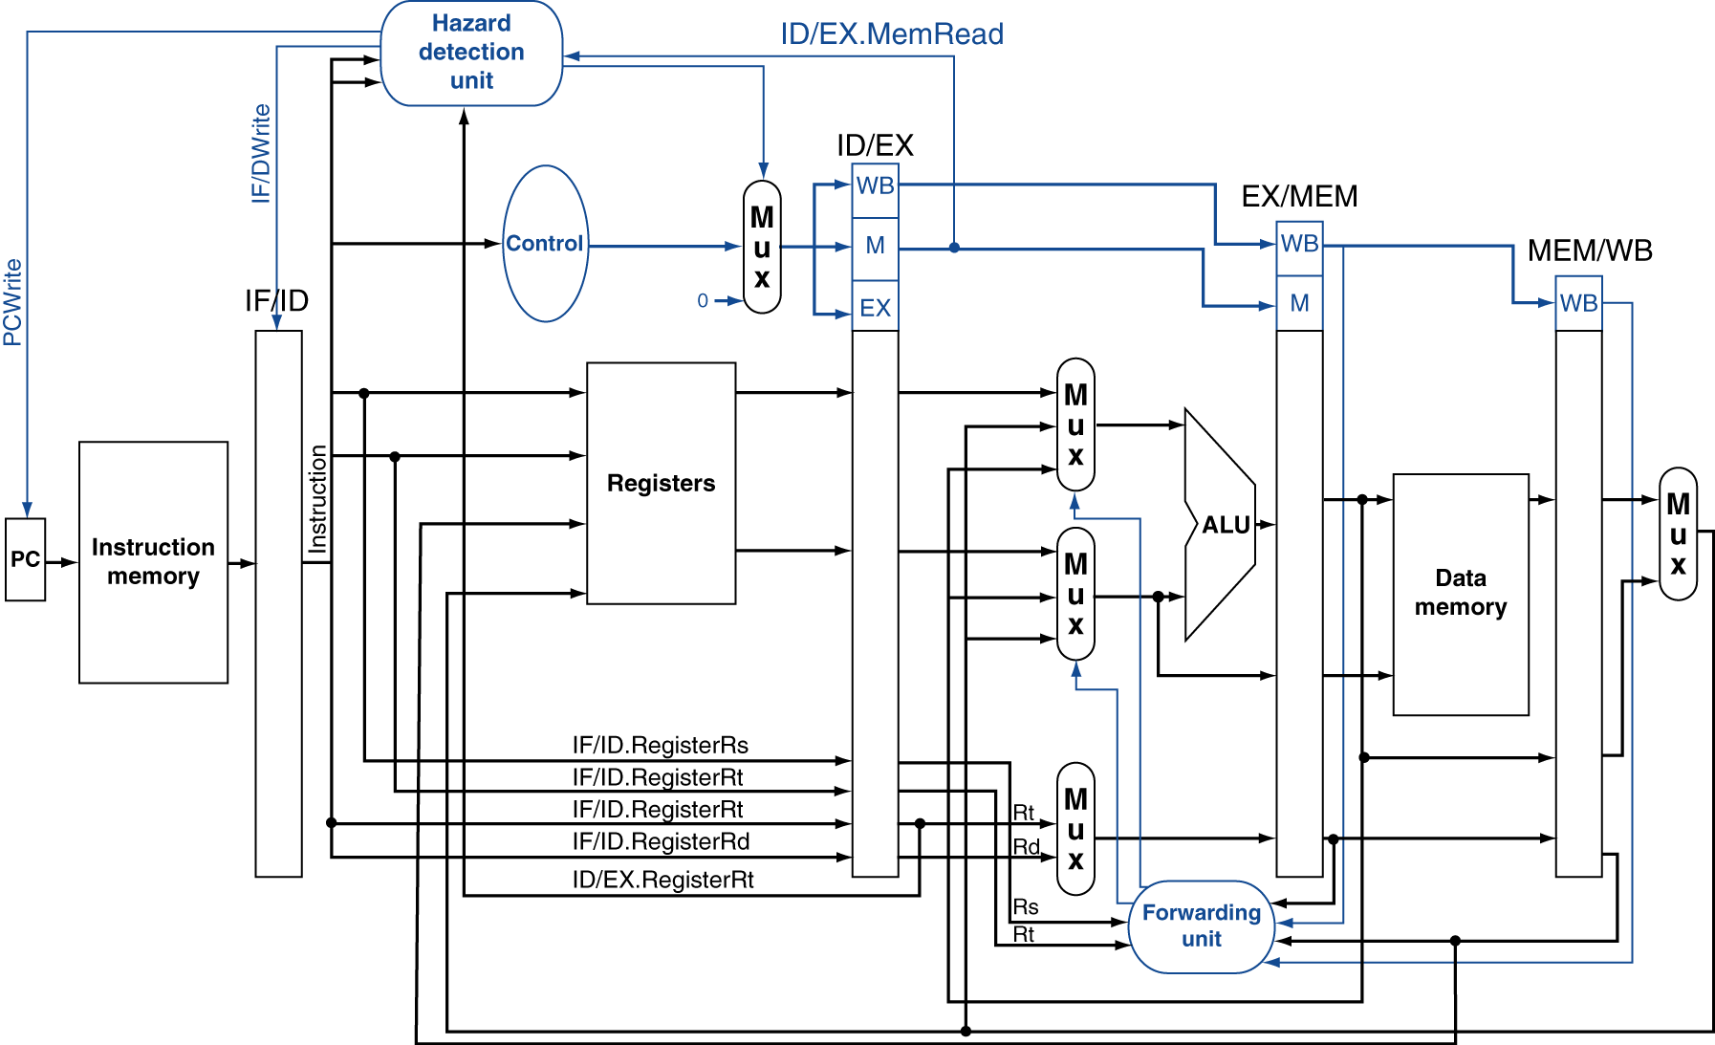
Datapath with Hazard Detection

Slide 8
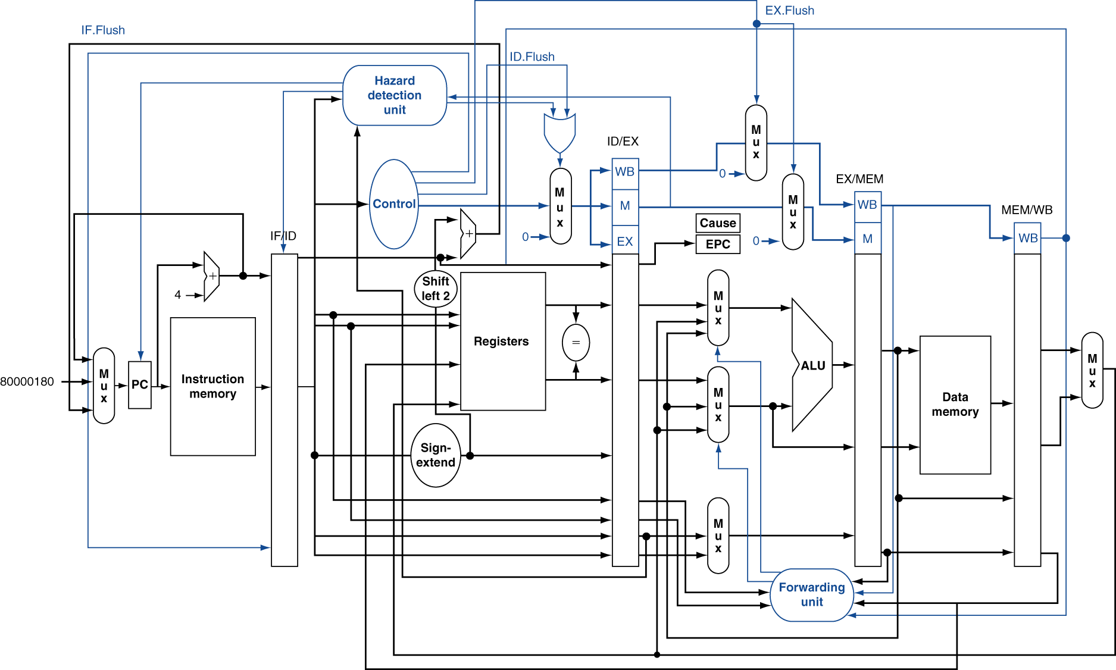
Pipeline with Exceptions

Slide 9
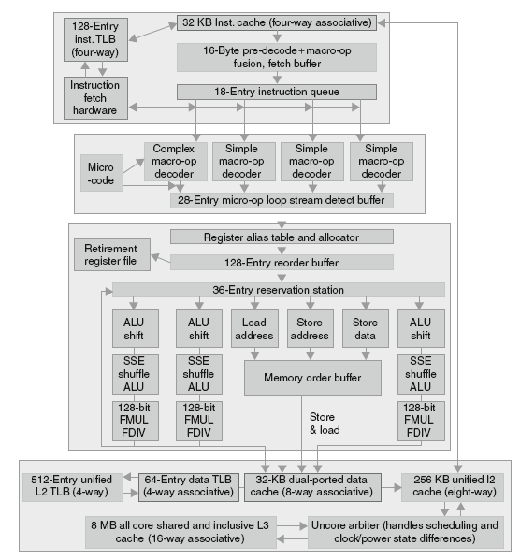
Core i7 Pipeline
14 stages

